Slide 1
Dose-toxicity characterization of silver nanoparticles
Brielle Januszewski (Scholar)
Ana C. Barrios (Mentor)
Dr. François Perreault (PI)

Slide 2
introduction
Graphene Oxide
+
Silver Nanoparticle Doped Graphene Oxide
Silver Nanoparticles

Slide 3
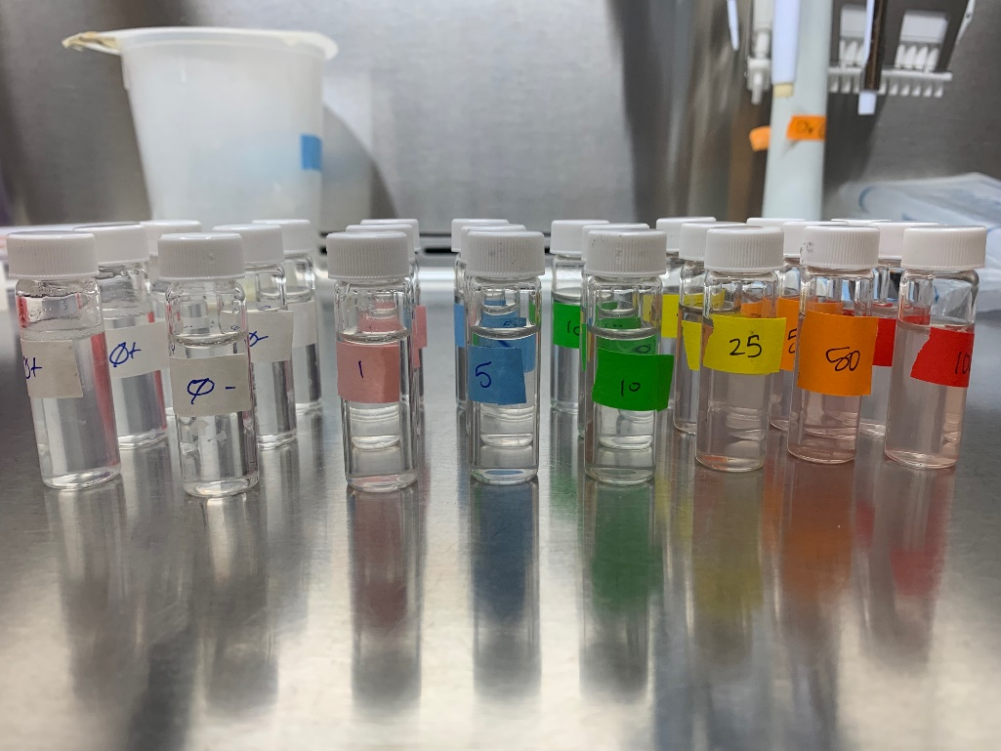
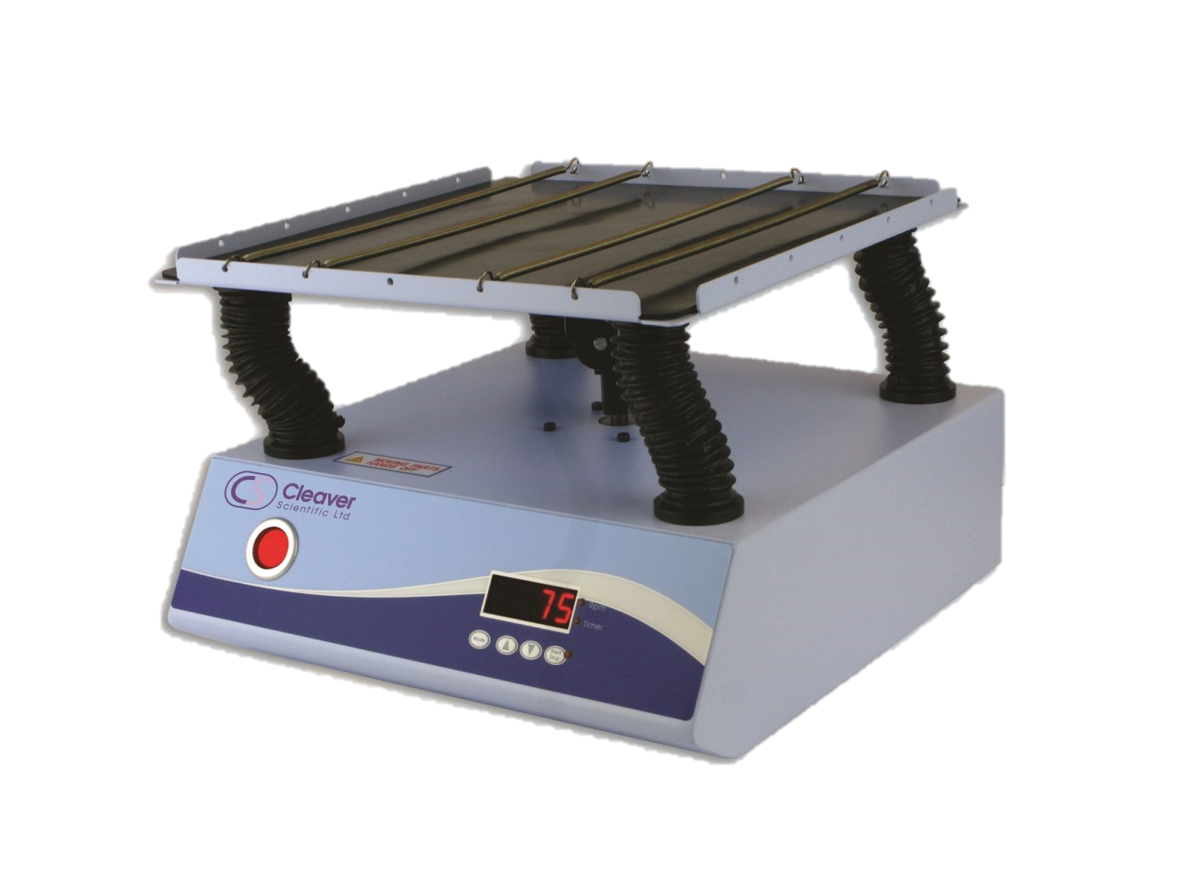
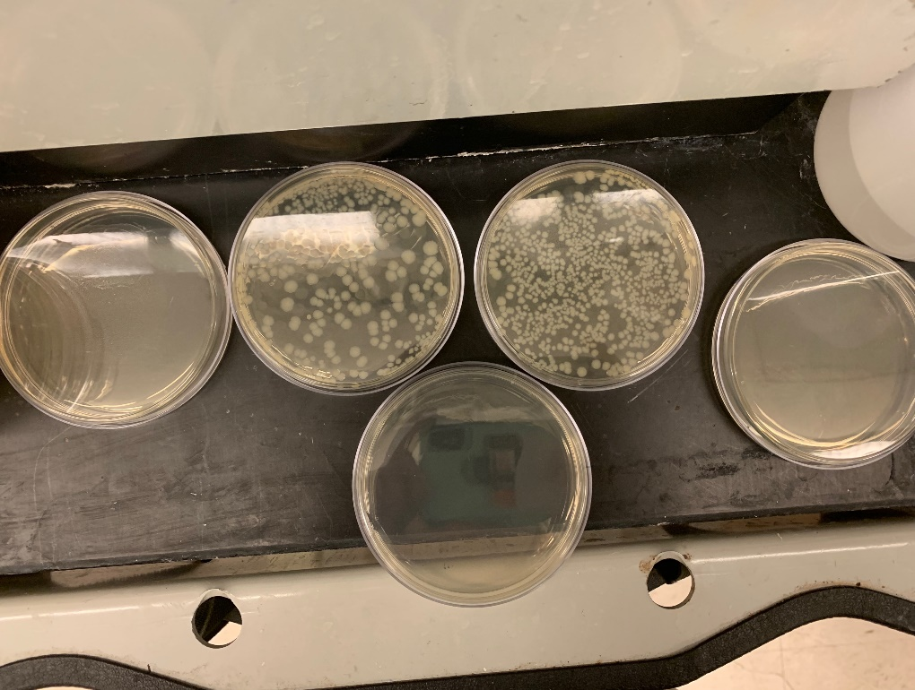
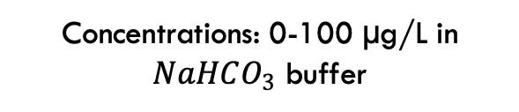
Materials and methods
Ag NPs of different sizes
100 nm
50 nm
20 nm
Concentrations: 0-100 µg/L in $NaHCO_{3}$ buffer
E. coli cells were cultured and mixed with Ag NPs
3 h exposure
Room Temperature
Plates after incubation with E. coli colonies

Slide 4
Initial results
Difficult to quantify dose-toxicity
AgCl precipitates form after AgNPs reacts with NaCl
Antimicrobial Activity of AgNPs in NaCl solution

Slide 5
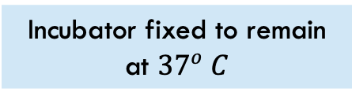
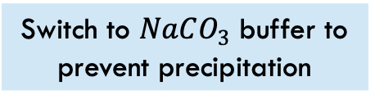
ongoing results
Silver precipitated by the chlorine in the NaCl buffer
Switch to $NaCO_{3}$ buffer to prevent precipitation
New buffer prevents growth
pH adjust buffer after autoclaving
Bacteria won’t grow after plating
New agar not conducive to growth
Bacteria won’t grow during incubation
Incubator fixed to remain at ${37}^{o} C$

Slide 6
ongoing results
Bacteria are killed at low concentrations
Excess silver removed with nitric acid wash
Bacteria are still killed at low concentrations
Additional rinsing to remove nitric acid
Bacteria in the negative control won’t grow
Switch to disposable plastic tubes/fresh glass vials
Bacteria in the negative control still won’t grow
Use lower silver nanoparticle concentrations

Slide 7
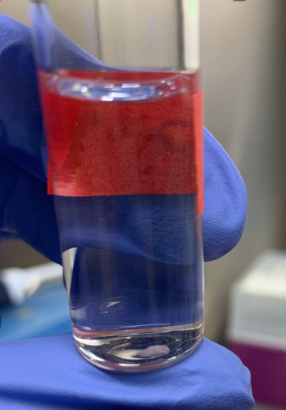
conclusion
Bacteria is sensitive to many different factors outside of the target contaminant.
Chloride ions in a NaCl solution precipitates much of the silver in solution.
Bacteria is indeed sensitive to silver.
Silver precipitate after contact time in NaCl solution

Slide 8
Future work
Complete the characterization of silver ions and silver nanoparticles of varying sizes from 20nm to 300nm.
Synthesize silver-doped graphene oxide.
Characterize the dose-toxicity of AgNP-doped GO.

Slide 9
acknowledgements
I would very much like to thank my PI, Dr. François Perreault for being such a good mentor and for supporting me in my post-graduation plans. I would also like to thank my graduate student mentor, Ana, for being such a patient teacher and giving me all the skills I need to be a independent researcher. Finally, I would like to thank my lab mates for being so welcoming and helpful in the lab.

Slide 10
References
Soo-Hwan, K., Lee, H., Ryu, D., et al. (2011) Antibacterial Activity of Silver-nanoparticles Against Staphylococcus aureus and Escherichia coli. Korean J. Microbiol. Biotechnol. 39 (1) 77-85.
De Faria, A., Perreault, F., Shaulsky, E., et al. (2015) Antimicrobial Electrospun Biopolymer Nanofiber Mats Functionalized with Graphene Oxide-Silver Nanocomposites. Applied Materials & Interfaces, 7, 12751-12759. https://doi.org/10.1021/acsami.5b01639
SCHER (2012) Toxicity and Assessment of Chemical Mixtures. https://doi.org/10.2772/21444
Chen, J., Zongming, X., Lowry, G. V., et al. (2011) Effect of natural organic matter on toxicity and reactivity of nano-scale zero-valent iron. Water Research, 45, 1995-2001. https://doi.org/10.1016/j.waters.2010.11.036

